Slide 1
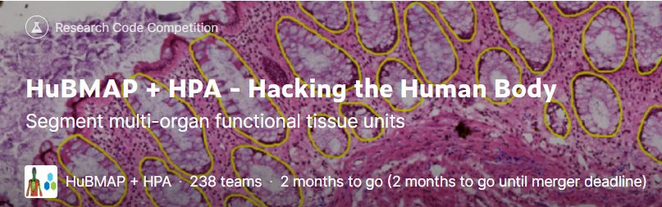
HuBMAP + HPA – Hacking the Human Body
Progress Meeting 4 Group A
https://www.kaggle.com/competitions/hubmap-organ-segmentation

Slide 2
01
Finetune
CONTENTS
02
Data preprocessing
03
Further improvements

Slide 3
1. Finetune
Briefly introduction :
“Finetune” means using models trained by others on our own data to train new models/Copy parameters directly from someone else's already trained network and train new models against our own data
The aim of finetune:
Without completely retraining the model, we can directly obtain the underlying parameters that we find difficult or impossible to train, thus improving efficiency. While new training models tend to start from very low levels of accuracy and work their way up, Fine Tune allowed us to get better results with fewer iterations.

Slide 4
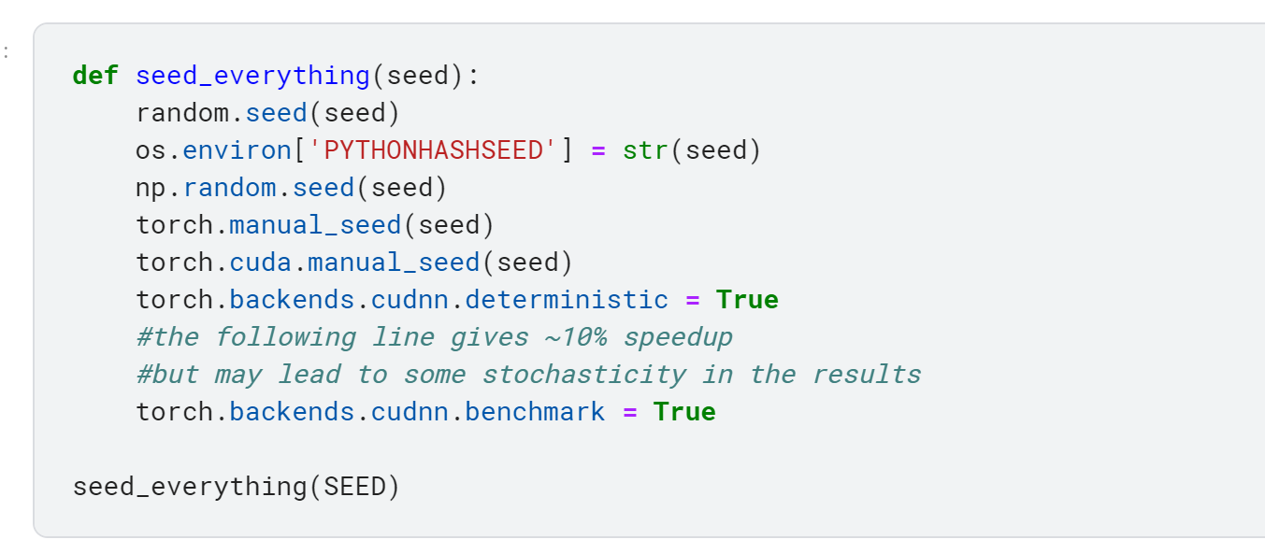
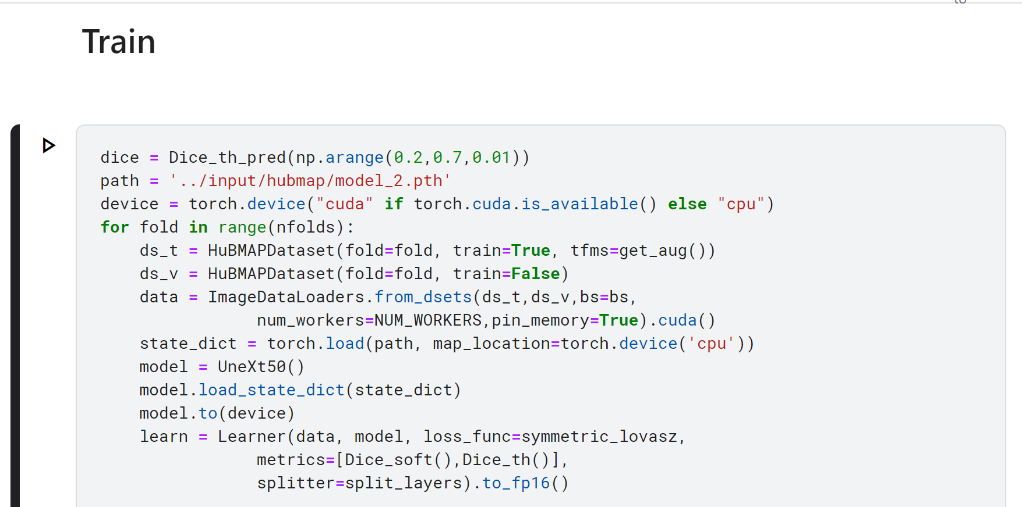
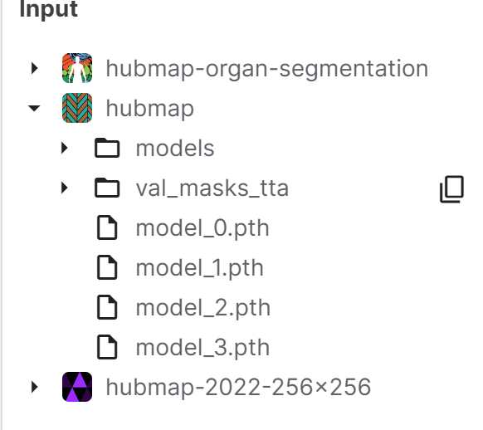
1. Finetune
Work with group c
Training model:
Torch gives all parameters in the model a random initialization
Use seed to make the initialization the same - to make a fair comparison between the new models that emerge at each training session
The training process is equivalent to continuously optimizing the parameters in the model
Finetune:
The parameters of the model are initialized not by random but by previously trained parameters at the beginning
On this basis, we use our data set to train the model and make it continue to optimize to adapt to our data set, thus to get better results

Slide 5
1. Finetune
Fine-tune practice tip:
Change learning rate. Better use a smaller learning rate when retraining. Because the weights of trained network models are smoothed, we do not want to distort them too quickly.
https://blog.csdn.net/qq_45723511/article/details/108174785
https://blog.csdn.net/clearch/article/details/80231127?utm_term=finetune%E7%9A%84%E5%A5%BD%E5%A4%84&utm_medium=distribute.pc_aggpage_search_result.none-task-blog-2~all~sobaiduweb~default-0-80231127-null-null&spm=3001.4430

Slide 6
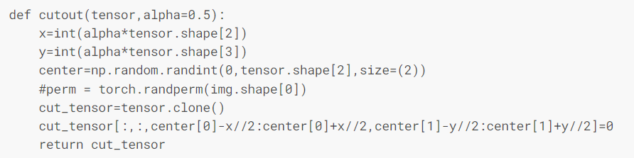
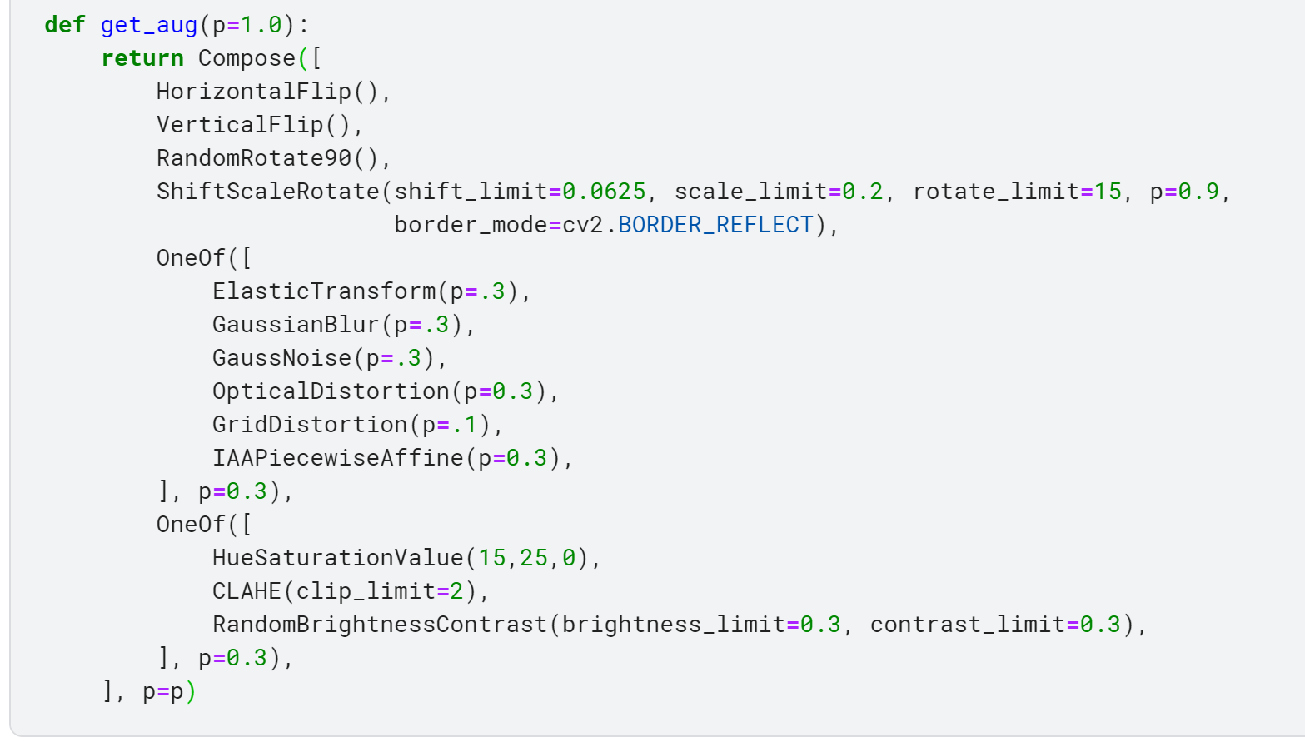


Our additional attempt
Use cutout when firstly training the model
Add these three data augmentation methods when retraining
the model
Results:

Slide 7
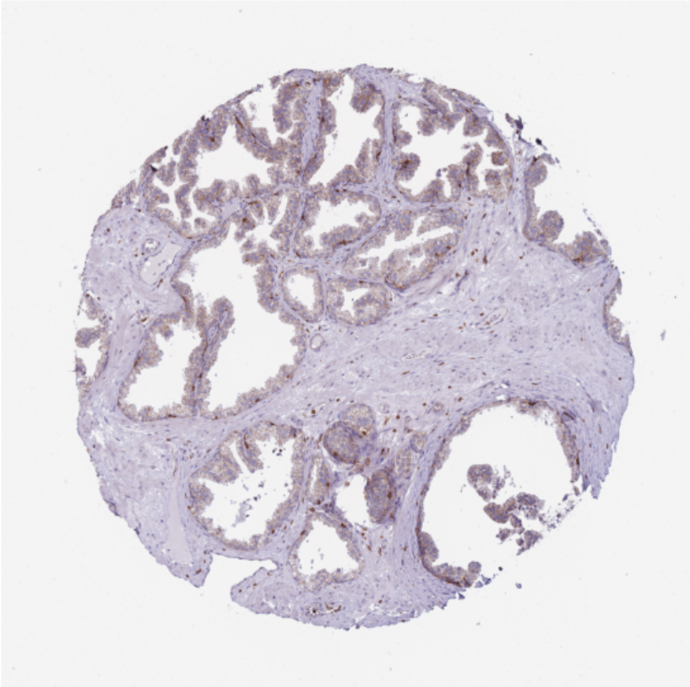

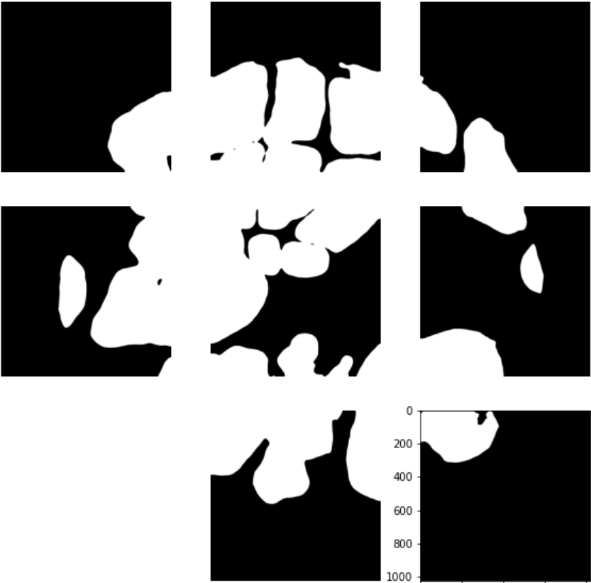
STRATEGY
OBSERVATION ON DATA
Image
Label
Predict result
Predict result is predicted by a model got 0.62 score.
As can be seen from above three images, there is a big difference between label and predict.

Slide 8
STRATEGY
OBSERVATION ON DATA
Image
Label
Predict
There are some positions that look like labels, but they are not labels.
These positions have been marked with boxes and labeled by the model.

Slide 9
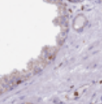
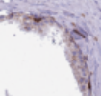
STRATEGY
OBSERVATION ON DATA
The above two tiles are taken from the whole image. The size of the whole image is 3000x3000 and the size of the tiles is 256x256.
As mentioned in last page. There are some positions that look like labels, but not labels. Red box is ground truth, however, green box is not ground truth.

Slide 10
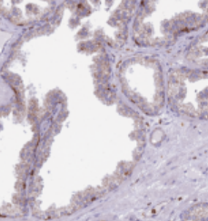
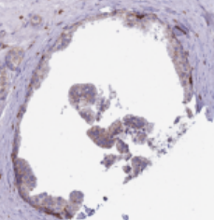
STRATEGY
OBSERVATION ON DATA
In order to distinguish between red boxes and green boxes, tiles should combine more information and use larger tiles

Slide 11
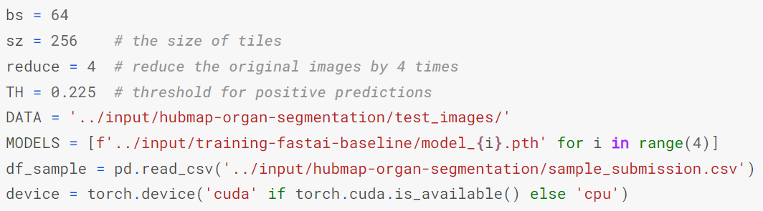
STRATEGY
IMAGE SIZE
In the step of inference, the test images are divided into many tiles and tiles are reduced by 4 times.
The operation of reducing the images by four times will inevitably lead to the loss of information of the images.
However, the model parameters are trained by 256x256 size images, and such models have poor prediction results for 512x512 size images, which is mentioned in paper ‘YOLOv3: An Incremental Improvement.’
YOLOv3: An Incremental Improvement: https://pjreddie.com/media/files/papers/YOLOv3.pdf

Slide 12
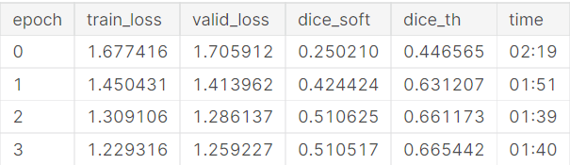
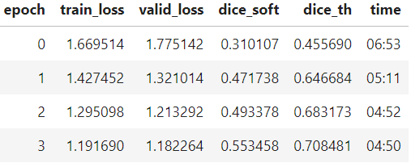
STRATEGY
STRATEGY
Strategy:
Because the size of the images in the dataset are too large, which will lead to CUDA out of memory, we should cut each images in the dataset into many tiles, but combined with the previous ppts, the size of the tiles should not be too small, so we are going to adjust the size of the tiles from 256x256 to 512x512.
256x256 size tiles
512x512 size tiles
From above two figures, 512x512 size tiles got better dice result.

Slide 13
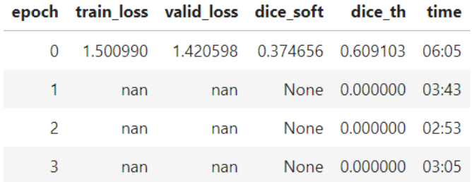
STRATEGY
STRATEGY
However, using 512x512 tiles leads to CUDA out of memory.
To avoid CUDA out of memory, we reduce the batch size from 64 to 30. Although the problem of CUDA out of memory is solved, there is another problem.
Loss and dice all became nan or 0.0.
We haven‘t fixed this problem yet. We guess the dice value in a batch is Nan, thus when the dice of epoch is finally calculated, the dice of the whole epoch is Nan.

Slide 14
03
Further improvement
Fix the problem that loss and dice are Nan or 0
Train a model that suitable for 512x512 size data

Slide 15
Thank You!

